Slide 1
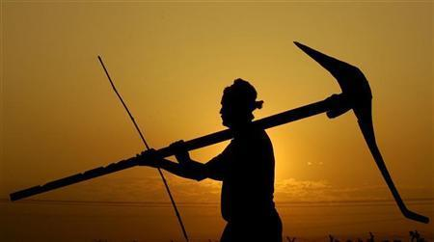



Fikar na Karo We are with you !!!

Slide 2
Problem Statement
Lack of relevant information availability to farmers
Current information services are too generalised and lack the local context
Knowledge and information are one of the most critical lacking element in current farming
Existing systems are not simple and comprehensive

Slide 3
Proposal !!
integrated platform for information need of farmer
One stop information solution for all needs of farmer: right from sowing to marketing
Integrates:
Input management
Agricultural advisory services
Weather information and advisories
Rental and custom hiring services (aggregation model) and
Market information services

Slide 4
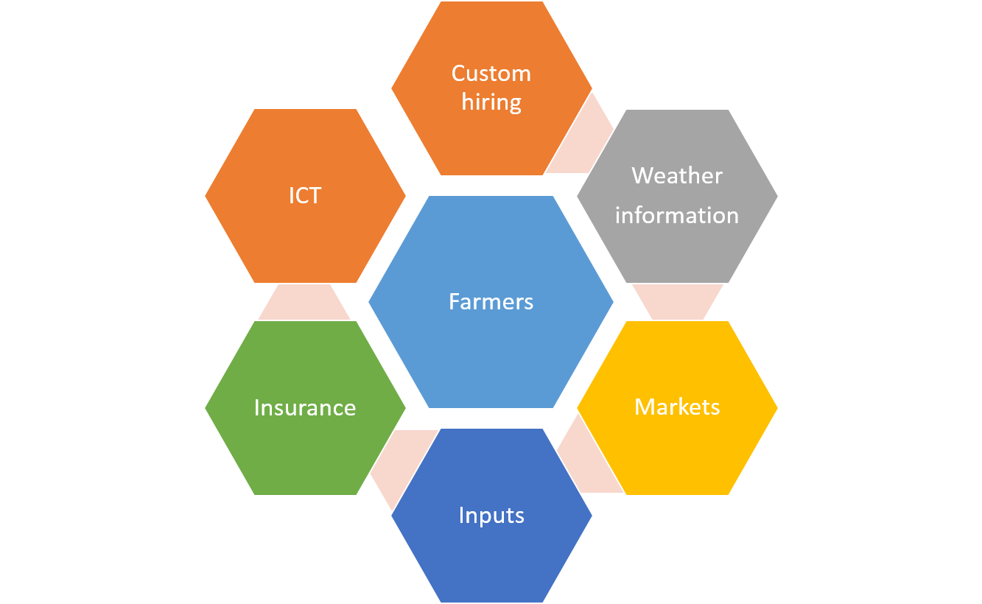
What’s new ?
Simple application
Local context
24×7 availability through cloud
Uses big data analytics and
Comprehensive package

Slide 5
Business Model
Technology involved
Use gram panchayat Offices for displaying information
Initial investments from local government; NGOs and agricultural entrepreneurs
Long term aim is to have self sustaining business model
Mobile apps + SMS
Microsoft Technologies
Azure cloud
MS Sql Server
Power BI
aWhere API’s
Weather Report
Plantation/models
Data Analytical tools
Hadoop/pentaho/

Slide 6

Farmers Management portal
aWhere Weather API
Weather Report
Market Place
Management Practices
Disease Management
Expert Advice
Crops info
Farmer info
Current and
probable price after 6 months
Ploughing
Seed treatment
Time of sowing
spacing
critical stages of moisture requirement
weeding/ intercultural opetations
recommended fertilizers and its dosage
pest
symptoms
remedy
micro nutrient deficiency
symptoms
remedy
Other disease
symptoms
remedy
Expert system to address the queries of farmers
Auto answering system for the farmer queries
aWhere Weather API
Remote sensing data

Slide 7

Team :GREEN WARRIORS
Dr. Madhu Babu (Agriculture University)
Rabbani , Syed (ICRISAT)
Prasad (Hackrons)
Sravanthi (ICRISAT)
Paresh (CIMMYT)
Anupama (ICRISAT)
Vinod Kumar (Microsoft)
Upender (Microsoft)
Rayappa (Microsoft)

